Slide 1
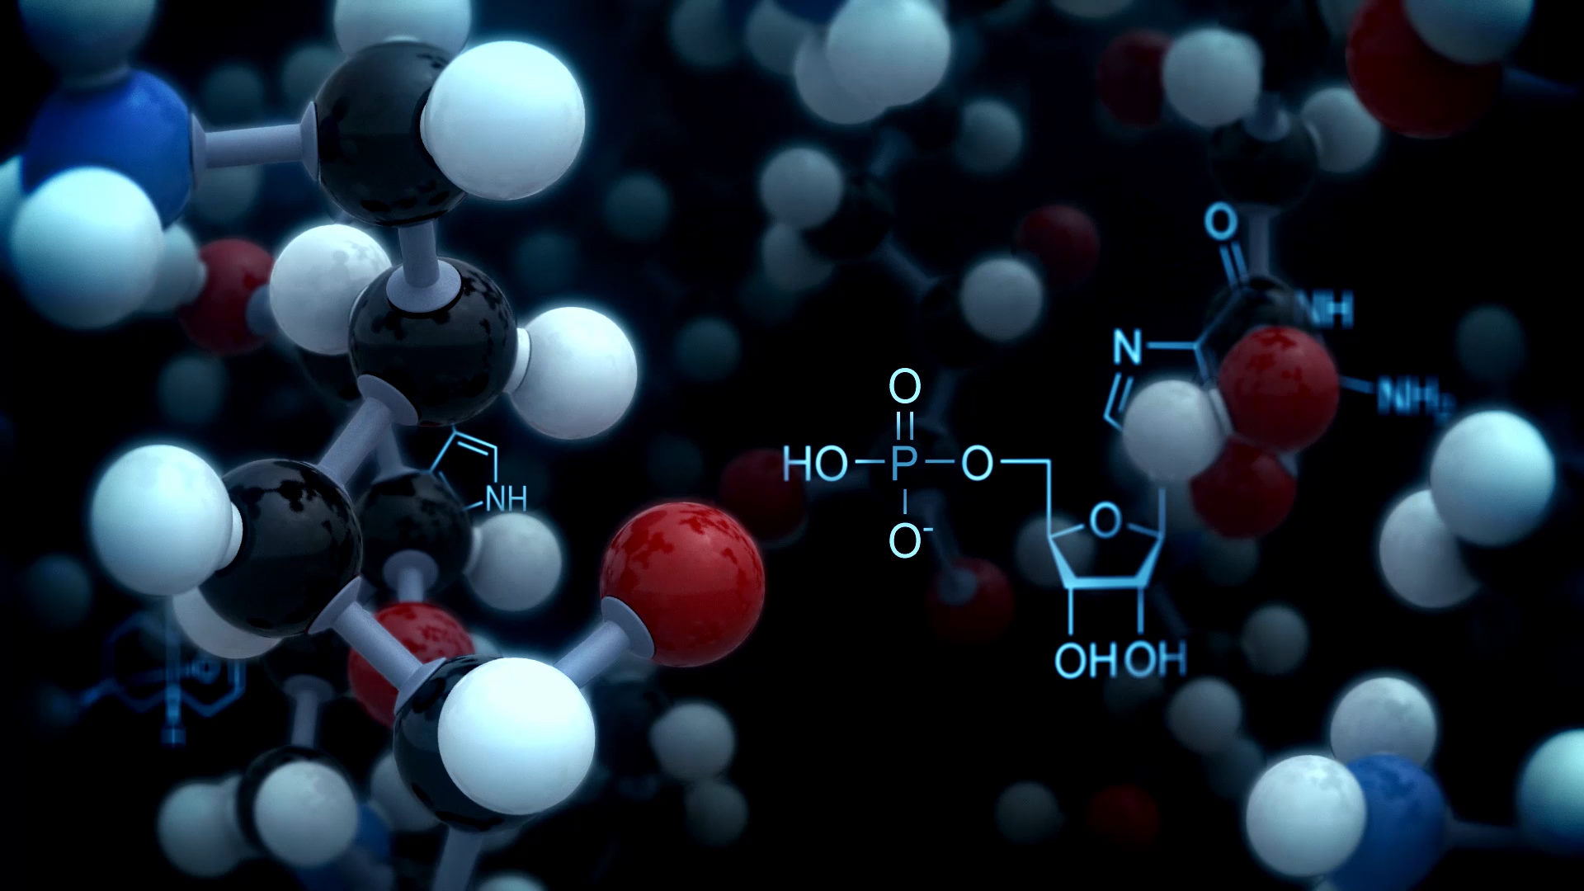

Intro to Molecules
Paweł Dąbrowski-Tumański
MiNI Lecture, Definitely Winter 2026

Slide 2


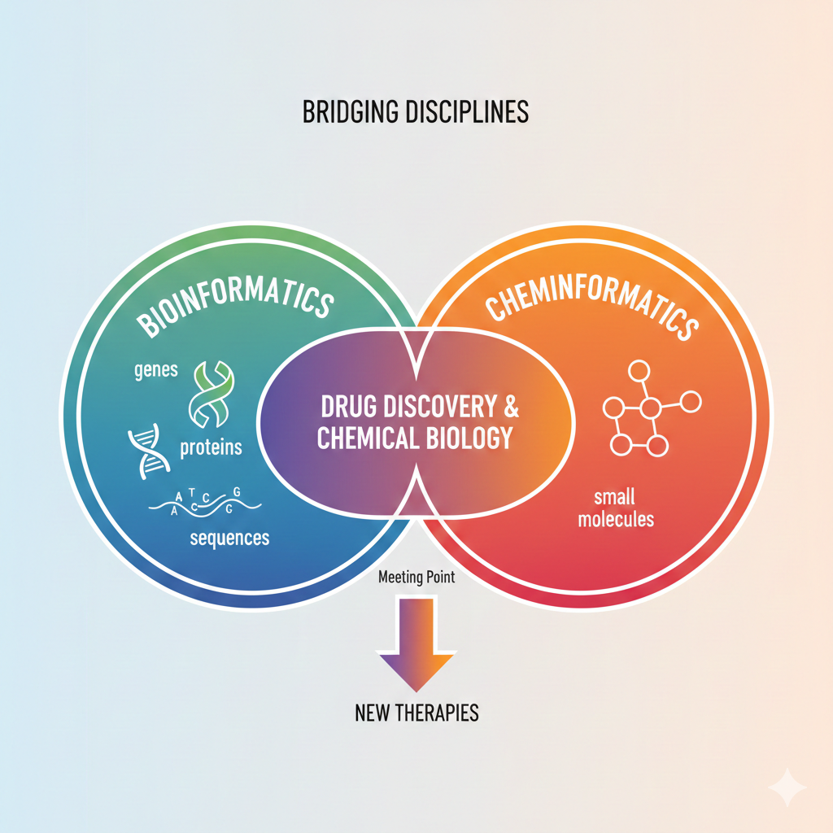






BIOINFORMATICS TO CHEMINFORMATICS

Slide 3
WHAT ARE SMALL MOLECULES?
⚛️ Low-molecular-weight chemical compounds
📏 Much smaller than proteins and nucleic acids
🔀 Structurally diverse and highly variable
🧩 Difficult to enumerate exhaustively

Slide 4
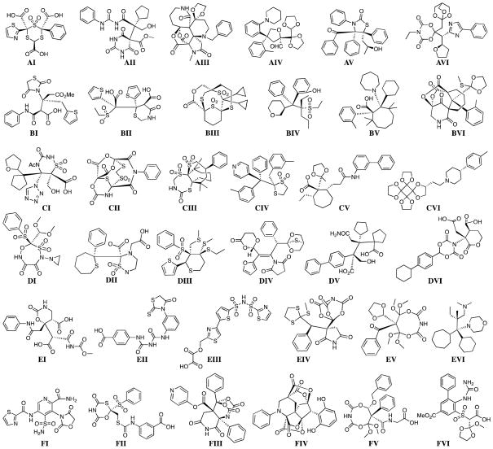
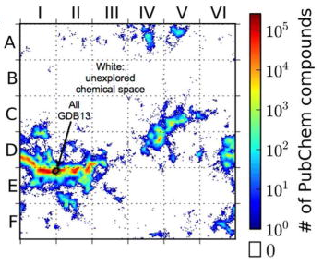
WHAT ARE SMALL MOLECULES?
Virshup, A. M., Contreras-García, J., Wipf, P., Yang, W., & Beratan, D. N. (2013). Stochastic voyages into uncharted chemical space produce a representative library of all possible drug-like compounds. Journal of the American Chemical Society, 135(19), 7296-7303.

Slide 5
SMALL MOLECULES VS PROTEINS AND DNA
🧬 Proteins and DNA are linear polymers
🧪 Small molecules are non-polymeric and irregular
📜 No unique canonical sequence for molecules
🧠 Representation is inherently ambiguous

Slide 6
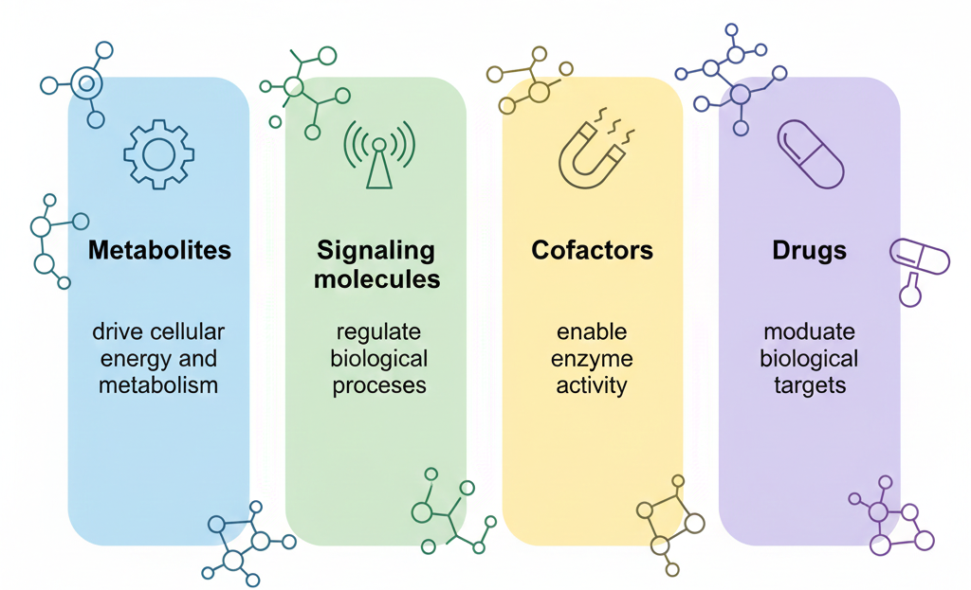
POSITIVE ROLES OF SMALL MOLECULES

Slide 7
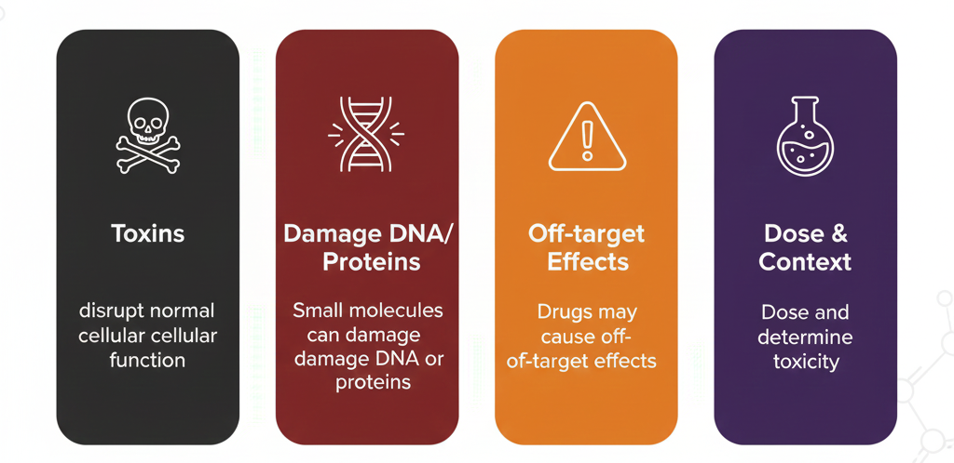
NEGATIVE ROLES: TOXINS, SIDE EFFECTS

Slide 8
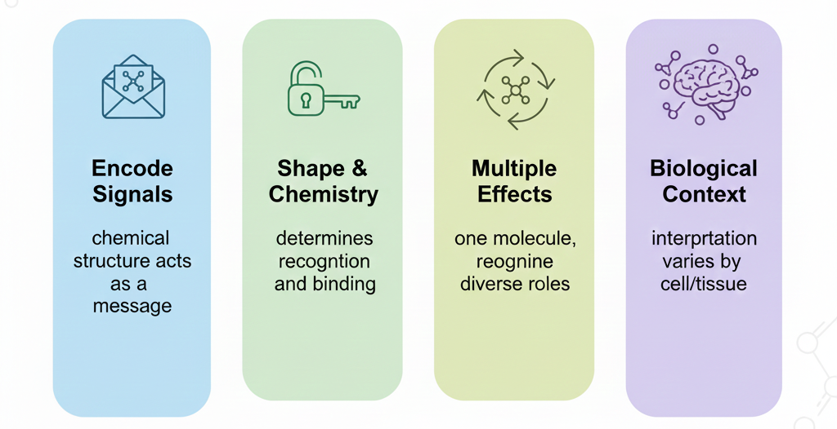
INFORMATION CARRIERS

Slide 9
WHY CARE ABOUT MOLECULES?
📊 Molecules generate massive datasets
🧮 Core problems involve graphs, strings, and vectors
🤖 Central to machine learning in life sciences
🌍 High impact in medicine and industry

Slide 10


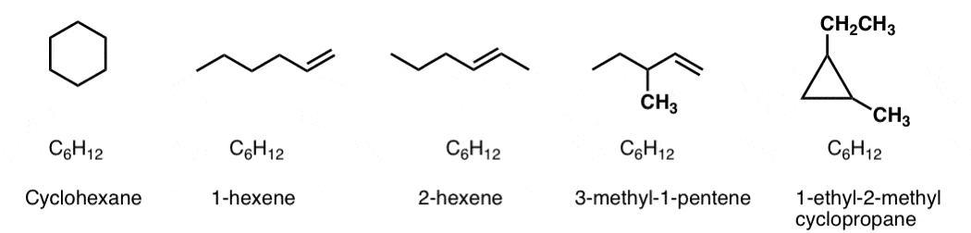
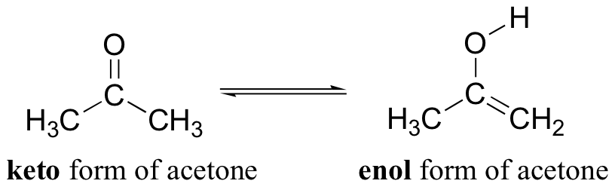
WHAT DOES IT MEAN "THE SAME"?

Slide 11
WHAT DOES IT MEAN "THE SAME"?
❓ Chemical sameness depends on definition and context
🧪 Identical formulas do not imply identical molecules
💻 Computers require explicit equivalence rules

Slide 12
PHYSICAL OBJECTS VS DATA OBJECTS
⚛️ Physically, molecules are dynamic 3D entities
💾 Digitally, molecules are stored as symbols or graphs
🧠 Data models approximate chemical reality
🔄 Conversion always loses information

Slide 13
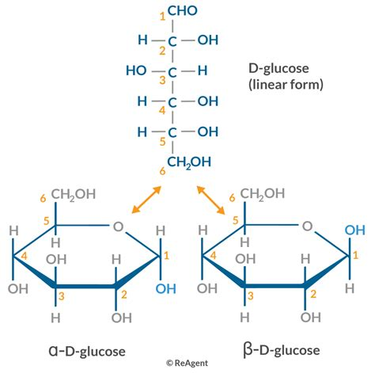
ONE MOLECULE, MANY DESCRIPTIONS
✏️ Same molecule can be drawn in many ways
🔀 Atom ordering changes textual representations

Slide 14
CANONICAL SEQUENCES DO NOT EXIST
🧬 No natural linear ordering of atoms
🔁 Cycles and branches complicate serialization
🧮 Canonicalization depends on algorithms
⚖️ Different tools produce different results

Slide 15
REPRESENTATION AS A DESIGN CHOICE
🎨 Representation encodes assumptions
🧠 Different tasks need different views
⚙️ Precision trades off with simplicity
📐 No universally optimal representation

Slide 16
REPRESENTATION VS COMPUTATION
🧮 Algorithms operate on representations, not molecules
⚡ Performance depends on encoding choice
🔍 Search and comparison are representation-specific

Slide 17
MOLECULAR FORMULA IS NOT ENOUGH
🧾 Formula counts atoms but ignores structure
🔗 Connectivity defines chemical identity
🧪 Many molecules share the same formula

Slide 18
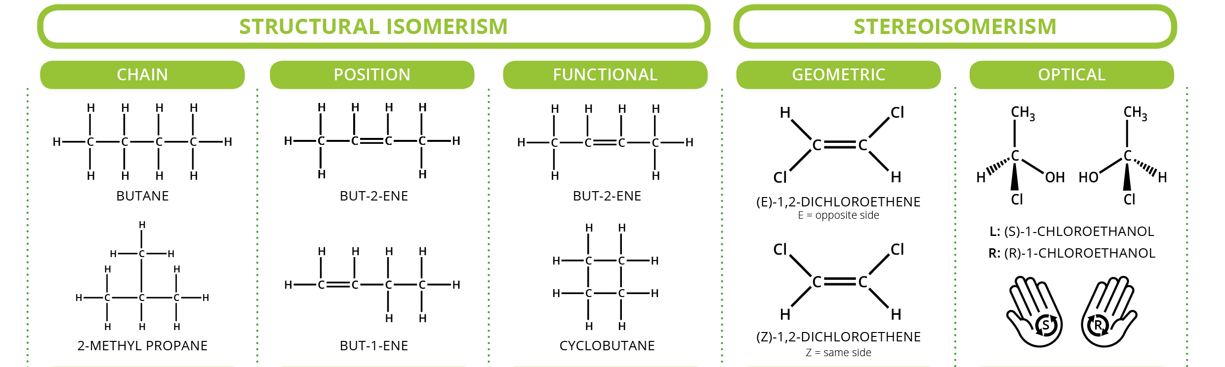
ISOMERS

Slide 19
STRUCTURAL ISOMERS
🧩 Different atom connectivity patterns
🧮 Represented as distinct molecular graphs
💊 Often radically different biological effects
🔍 Graph structure is crucial for identity

Slide 20
STEREOISOMERS
🪞 Same graph, different 3D arrangement
🧬 Enantiomers interact differently with proteins
⚖️ Chirality must be explicitly encoded
💊 One isomer may be active, another harmful

Slide 21
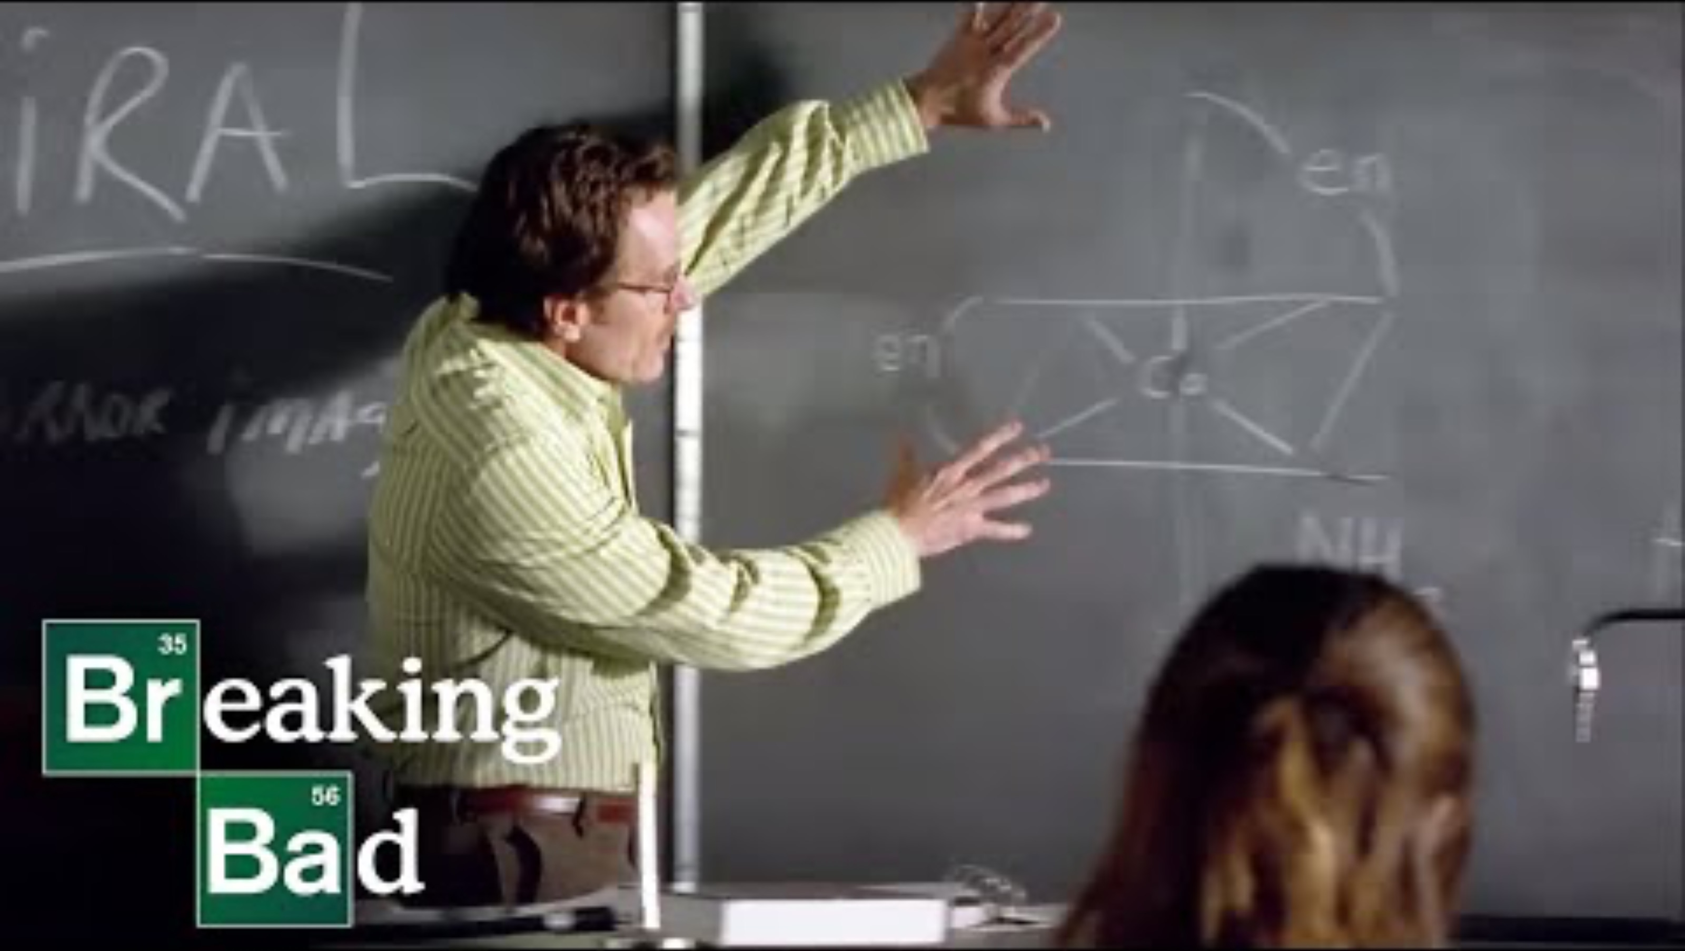
STEREOISOMERS

Slide 22
GEOMETRIC ISOMERS: CIS–TRANS EFFECTS
🔀 Restricted rotation around bonds
📐 Spatial arrangement affects function
🧠 Often invisible in simple 2D graphs
⚠️ Must be captured by representation

Slide 23
TAUTOMERS: KETO–ENOL AND BEYOND
🔄 Rapid interconversion between forms
🧪 Different bonding patterns, same atoms

Slide 24
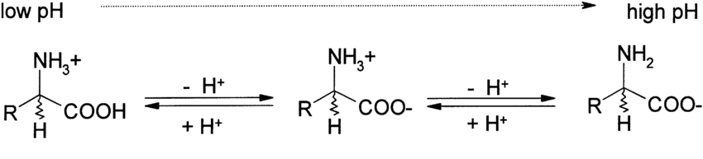
PROTONATION AND PH DEPENDENCE
⚡ Gain or loss of protons changes charge
🔌 Charge affects solubility and binding

Slide 25
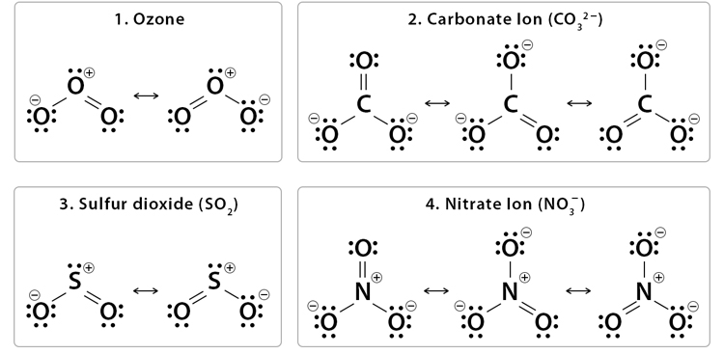
RESONANCE STRUCTURES

Slide 26
RESONANCE STRUCTURES
🔁 Multiple Lewis structures possible
⚛️ Electrons are delocalized in reality
📄 Single structure is an approximation
🧠 Resonance challenges graph models

Slide 27
CONTEXT VS STATIC REPRESENTATION
🌍 Environment affects molecular behavior
🧪 Solvent, pH, and binding partners matter
📸 Representations are static snapshots
❓ Which context should computation assume?

Slide 28

EARLY LINE NOTATIONS IN CHEMISTRY
✍️ Text-based encodings predate modern databases
📄 Designed for human readability and storage
🧪 Early formats lacked formal guarantees
💻 Set the stage for computational chemistry

Slide 29
SMILES: DESIGN GOALS AND BASIC IDEA
🧵 Linear strings encode molecular graphs
🔗 Parentheses represent branches and cycles
👁️ Human-readable and compact
💻 Widely used in software and databases

Slide 30
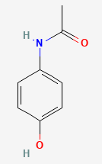
SMILES: DESIGN GOALS AND BASIC IDEA
🧪 Acetaminophen =
= 4'-Hydroxyacetanilide
= Paracetamol
✍️ SMILES: CC(=O)NC1=CC=C(C=C1)O
Or…
CC(=O)Nc1ccc(O)cc1

Slide 31

SMILES: GOOD WILL HOUNTING

Slide 32
ONE MOELCULE -> MANY SMILES
🔀 Atom ordering affects SMILES output
✏️ Same graph → many valid strings
⚠️ String equality ≠ molecular equality
🧪 Comparison requires normalization

Slide 33
CANONICAL SMILES AND ITS LIMITATIONS
🧮 Algorithms impose a consistent ordering
⚙️ Canonicalization is tool-dependent
❗ Different toolkits → different SMILES
🧠 Canonical does not mean chemically unique

Slide 34
SMILES AND LOSS OF CHEMICAL CONTEXT
📄 Static encoding ignores environment
⚡ Protonation and tautomers not resolved
🔁 Resonance collapsed into one form
⚠️ Biological relevance may be obscured

Slide 35
SELFIES
📐 Defined by a formal, context-free grammar
🛡️ Guarantees syntactically valid molecules
🤖 Designed for generative ML models
🔁 Always maps to a valid graph

Slide 36
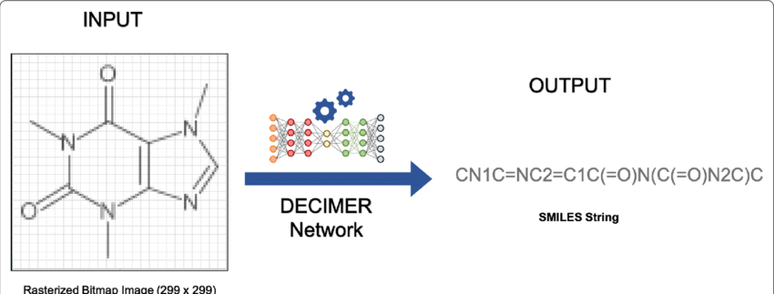
INTERLUDIUM - DECIMER
📐 Captures SMILES from image

Slide 37
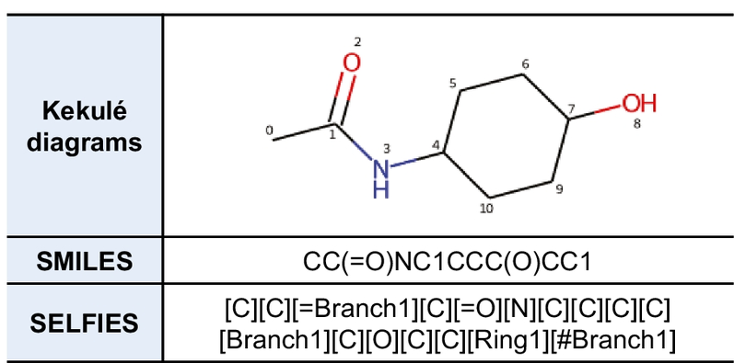
SELFIES

Slide 38
SELFIES VS SMILES
⚖️ SMILES allows invalid strings
🛡️ SELFIES prevents invalid chemistry
🤖 Better suited for neural generation
📊 Trade-off: readability vs robustness

Slide 39
LINE NOTATIONS AS FORMAL LANGUAGES
📚 Strings generated by grammatical rules
🧮 Parsers convert strings to graphs
💻 Familiar concepts from compiler design
🔍 Errors reflect language violations

Slide 40
THE NEED FOR UNIQUE IDENTIFIERS
🗂️ Databases require stable references
🔍 Fast lookup across systems
⚠️ Names and SMILES are ambiguous
📌 Identifiers enable data integration

Slide 41
INCHI: LAYERED MOLECULAR DESCRIPTION
🧱 Hierarchical layers encode structure
🔗 Connectivity, charge, and stereochemistry
🌍 Designed as a standard representation
📄 Human-readable but verbose

Slide 42
WHAT INFORMATION INCHI CAPTURES
🔗 Atomic connectivity
🪞 Stereochemical configuration
⚡ Formal charges and isotopes
🧪 Canonical structural identity

Slide 43
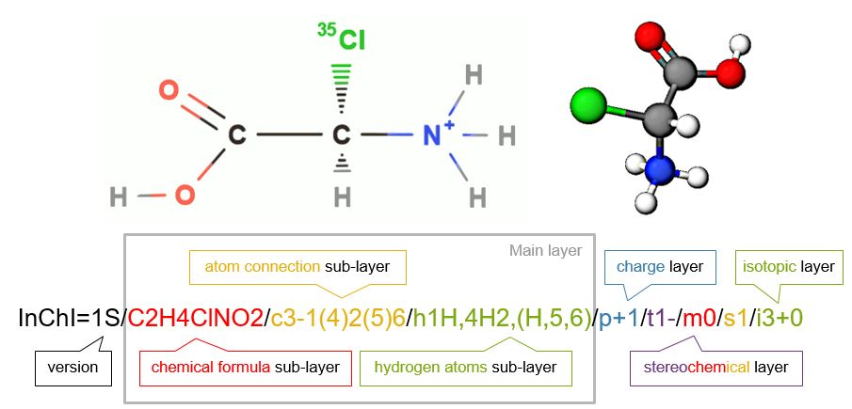
INCHI: EXAMPLE

Slide 44
WHAT INFORMATION DOES NOT
🌊 Solvent and environmental context
🔄 Dynamic tautomer equilibria
📐 Conformational flexibility
🧠 Biological activity or function

Slide 45
INCHIKEY: HASHED IDENTIFIERS
🔑 Fixed-length hashed representation
⚡ Fast comparison and indexing
🔒 Not reversible to structure
📎 Designed for database use

Slide 46
INCHIKEY FOR INDEXING AND SEARCH
🗃️ Enables fast exact matching
🌐 Widely used across databases
⚠️ No similarity information preserved
🔍 Suitable for lookup, not modeling

Slide 47
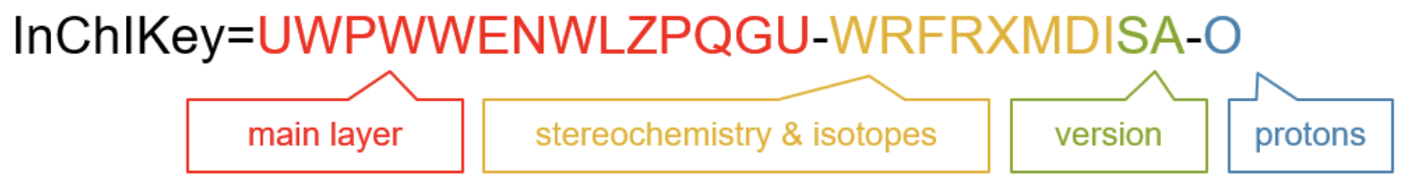
INCHIKEY: EXAMPLE

Slide 48
REPRESENTATION VS IDENTIFIER
🎭 Representations encode structure
🏷️ Identifiers label entities
🧠 Identifiers carry no chemical meaning
❓ Is a hash ever a representation?

Slide 49
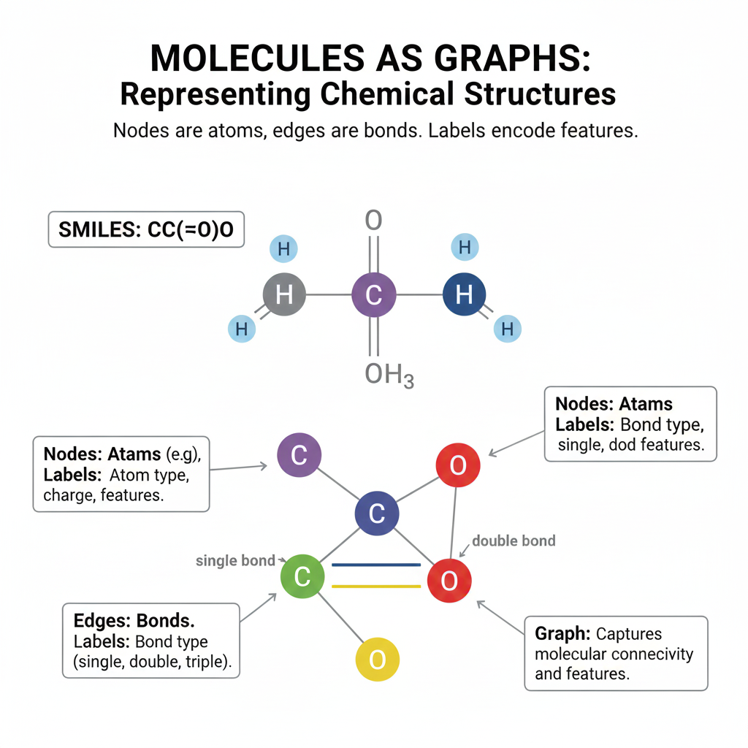

MOLECULES AS LABELED GRAPHS

Slide 50
MOLECULES AS LABELED GRAPHS
🧩 Atoms represented as nodes
🔗 Bonds represented as edges
🏷️ Labels encode atom and bond properties

Slide 51
ENCODING BOND TYPES AND AROMATICITY
➖ Single, double, triple bonds
⭕ Aromatic bonds as special cases
⚖️ Aromaticity depends on model choice
🧠 Encoding affects downstream algorithms

Slide 52
EXPLICIT VS IMPLICIT HYDROGENS
➕ Hydrogens may be stored or inferred
⚡ Implicit hydrogens reduce graph size
🧮 Explicit hydrogens increase precision
⚠️ Choice affects isomorphism and matching

Slide 53
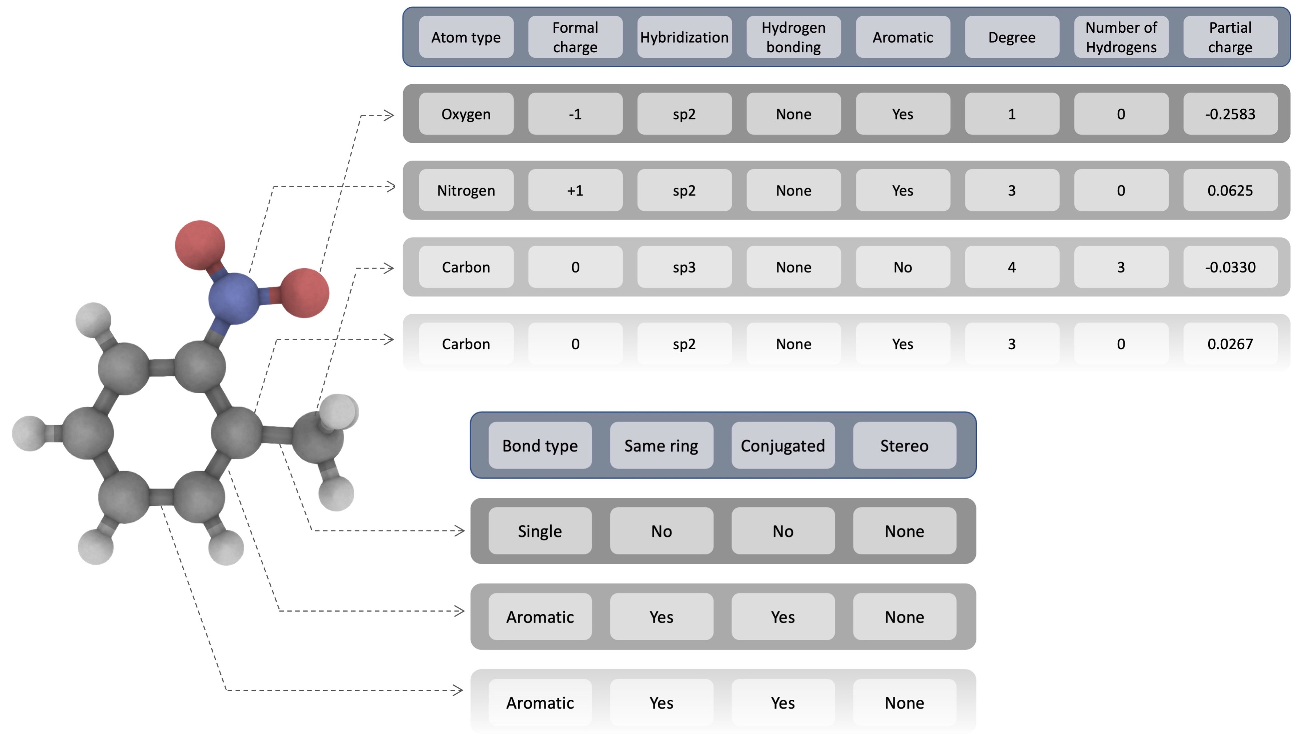
GRAPH EXAMPLE
Ansari, R., & Ghorbani, A. (2021). Accurate prediction of free solvation energy of organic molecules via graph attention network and message passing neural network from pairwise atomistic interactions. arXiv preprint arXiv:2105.02048.

Slide 54
GRAPH DIRECTIONALITY AND MULTIGRAPHS
↔️ Molecular graphs are usually undirected
🔀 Multigraphs allow parallel edges
🧩 Directionality used for reactions or flows
💻 Extends beyond simple graphs

Slide 55
STEREOCHEMISTRY IN GRAPHS
🪞 Chirality encoded via node attributes
📐 Cis–trans encoded via edge annotations
⚠️ Easy to lose in simplifications
🧠 Requires careful graph design

Slide 56
RESONANCE AND GRAPH AMBIGUITY
🔁 Multiple valid graph representations
⚛️ Electron delocalization not graph-native
📄 Single graph is an approximation
❓ Which resonance form should be used?

Slide 57
GRAPH ISOMORPHISM
🔍 Determine if two graphs are equivalent
🧮 Node and edge labels must match
⚠️ Computationally non-trivial problem
💻 Core of structure comparison

Slide 58
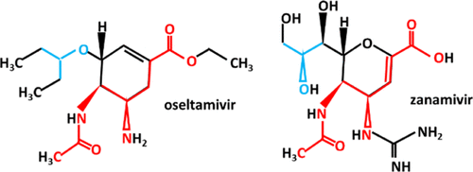
SUBSTRUCTURE SEARCH
Okamoto, Y. (2020). Finding a maximum common subgraph from molecular structural formulas through the maximum clique approach combined with the Ising model. ACS omega, 5(22), 13064-13068.

Slide 59
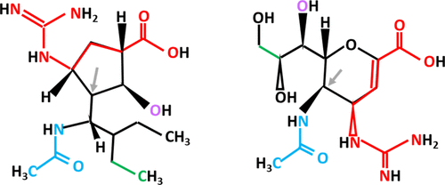
SUBSTRUCTURE SEARCH
Okamoto, Y. (2020). Finding a maximum common subgraph from molecular structural formulas through the maximum clique approach combined with the Ising model. ACS omega, 5(22), 13064-13068.

Slide 60
SUBSTRUCTURE SEARCH
🧩 Query graph matched inside target graph
🔗 Requires subgraph isomorphism
⚡ Central to chemical searching
❗ NP-complete in general case

Slide 61
COMPUTATIONAL COMPLEXITY
📈 Worst-case exponential complexity
🧮 Strong dependence on graph size
⚡ Heuristics used in practice
💻 Performance is representation-dependent

Slide 62
MAXIMUM COMMON SUBGRAPH (MCS)
🔍 Finds largest shared subgraph
📏 Used to quantify similarity
🧮 Computationally expensive
⚠️ Often approximated in practice

Slide 63
RING DETECTION AND CYCLE BASES
⭕ Rings are fundamental chemical motifs
🔁 Multiple cycles may exist
🧮 Algorithms find minimal cycle bases
⚠️ Different definitions yield different results

Slide 64
GRAPH CANONICALIZATION ALGORITHMS
🧮 Impose deterministic node ordering
🔁 Enable consistent serialization
⚠️ Algorithm-dependent outcomes
💻 Used in canonical SMILES and InChI

Slide 65
LIMITATIONS
🌊 No inherent notion of 3D geometry
⚡ Dynamics and environment ignored
🔁 Resonance and tautomers simplified
❓ Graphs are powerful but incomplete

Slide 66

FROM GRAPHS TO NUMBERS
🔢 Machine learning requires numeric input
🧩 Graphs must be vectorized
⚙️ Feature extraction is a design step
🧠 Numbers approximate structure

Slide 67
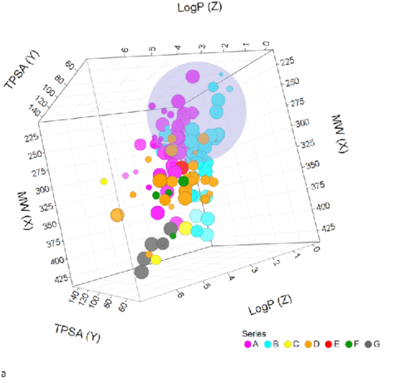
FROM GRAPHS TO NUMBERS
Hawryluk, N., Zhiru, L., Carlow, C., Gokool, S., Townson, S., Kreiss, T., ... & Scandale, I. (2022). Filarial nematode phenotypic screening cascade to identify compounds with anti-parasitic activity for drug discovery optimization. International Journal for Parasitology: Drugs and Drug Resistance, 19, 89-97.

Slide 68
PHYSICOCHEMICAL DESCRIPTORS
⚖️ Molecular weight, logP, polarity
📐 Global scalar properties
👁️ Interpretable by humans
⚠️ Limited structural resolution

Slide 69
PHYSICOCHEMICAL DESCRIPTORS
Descriptor name (RDKit) | Short description
MolWt | Molecular weight of the compound, representing the sum of atomic weights; important for drug-likeness and ADME properties.
LogP (MolLogP) | Octanol–water partition coefficient; measures lipophilicity and influences solubility, permeability, and bioavailability.
NumHDonors | Number of hydrogen bond donors (e.g., –NH, –OH); affects intermolecular interactions and binding.
NumHAcceptors | Number of hydrogen bond acceptors (e.g., N, O atoms); important for molecular recognition and solubility.
TPSA (Topological Polar Surface Area) | Surface area contributed by polar atoms; correlates with transport properties such as intestinal absorption and BBB penetration.
NumRotatableBonds | Count of rotatable single bonds; reflects molecular flexibility and conformational entropy.

Slide 70
STRUCTURAL FINGERPRINTS
🧱 Fixed-length binary representations
🔍 Encode presence of substructures
⚡ Fast comparison using bit operations
💻 Widely used for similarity search

Slide 71
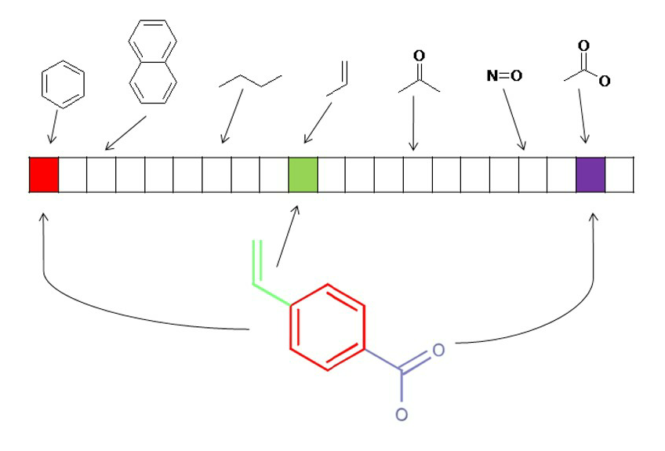
MACCS KEYS

Slide 72
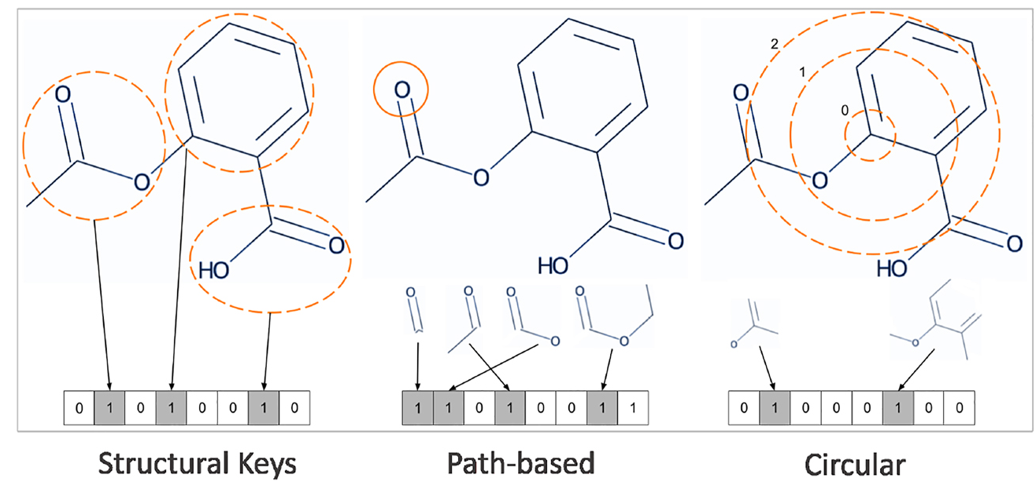
MORGAN (CIRCULAR) FINGERPRINTS

Slide 73
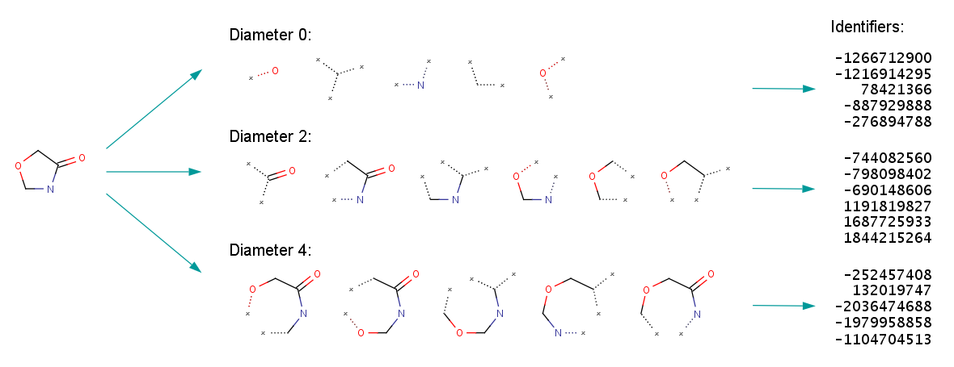
MORGAN (CIRCULAR) FINGERPRINTS

Slide 74
HASHING SUBSTRUCTURES
🔀 Map subgraphs to bit positions
⚙️ Enables fixed-length fingerprints
⚠️ Different structures may hash identically
🧠 Trade-off between size and precision

Slide 75
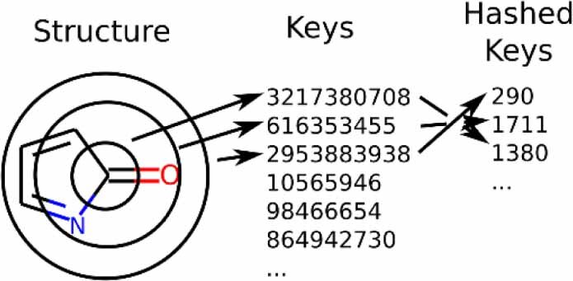
HASHING SUBSTRUCTURES

Slide 76
FINGERPRINT COLLISIONS
💥 Collisions merge distinct features
📉 Information is irreversibly lost
⚖️ Longer fingerprints reduce collisions
❓ How much loss is acceptable?

Slide 77
DRAWBACKS
📊 Number of bit set depends on the size
📐 ”Radius” is misleading
⚡ Bit colisions
🤖 No interpretation

Slide 78
LEARNING MOLECULAR REPRESENTATIONS
🤖 Manual features may miss patterns
📈 Data-driven representations adapt to tasks
🧠 Learning replaces feature engineering
⚠️ Interpretability often decreases

Slide 79
SMILES-BASED TRANSFORMERS
🧵 Treat SMILES as sequences
🤖 Transformers learn contextual embeddings
⚠️ Sensitive to SMILES canonicalization
📐 Grammar impacts learned representations

Slide 80
MOLFORMER AND SEQUENCE EMBEDDINGS
📚 Transformer models pretrained on SMILES
🔍 Capture long-range dependencies
📐 Output continuous vector embeddings
🤖 Enable transfer learning

Slide 81
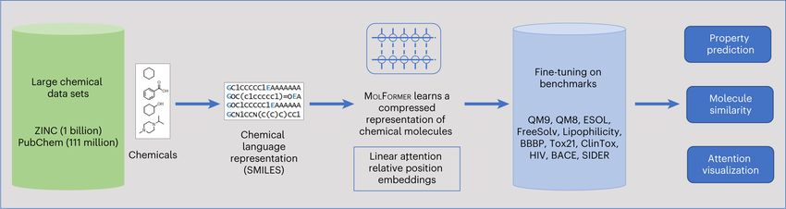
MOLFORMER AND SEQUENCE EMBEDDINGS

Slide 82
MESSAGE PASSING AND GRAPH EMBEDDINGS
📡 Nodes exchange information with neighbors
🔁 Iterative aggregation updates features
🧮 Produces fixed-length graph embeddings
🧠 Captures local and global structure

Slide 83
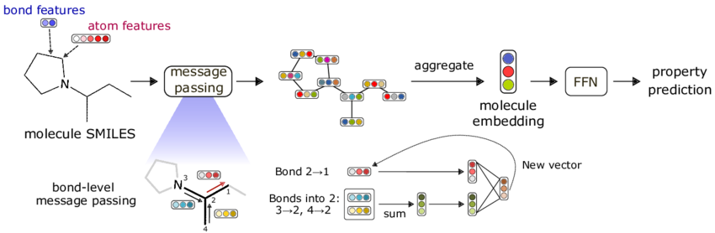
CHEMPROP

Slide 84
CHEMPROP
🧪 Uses message-passing neural networks
📊 Predicts biological and chemical properties
🔗 Operates directly on molecular graphs
💻 Widely used in cheminformatics research

Slide 85
WHAT DO EMBEDDINGS REPRESENT?
❓ Learned similarity replaces chemical intuition
🧠 Embeddings encode task-specific patterns
⚠️ Geometry in latent space is abstract
📊 Interpretation remains challenging

Slide 86

MOLECULAR SIMILARITY
🔍 Used for virtual screening and clustering
🧩 Predicts properties by analogy
📊 Basis for QSAR and ML models
⚠️ Assumes structure-function correlation

Slide 87
SIMILARITY DEPENDS ON REPRESENTATION
🧮 Fingerprints, embeddings, or SMILES
⚡ Different encodings yield different distances
🧠 Choice of representation biases results
❓ Which similarity is meaningful for the task?

Slide 88
TANIMOTO SIMILARITY FOR FINGERPRINTS
➗ Ratio of shared features to union
🔗 Common metric for binary fingerprints
⚡ Fast to compute using bit operations
❗ Sensitive to sparse fingerprints

Slide 89
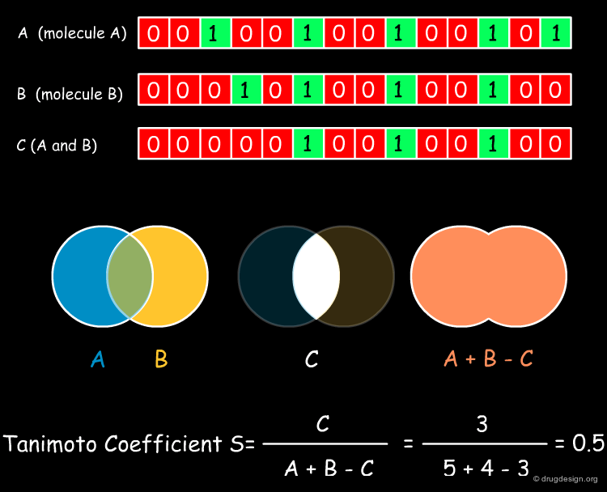
TANIMOTO SIMILARITY FOR FINGERPRINTS

Slide 90
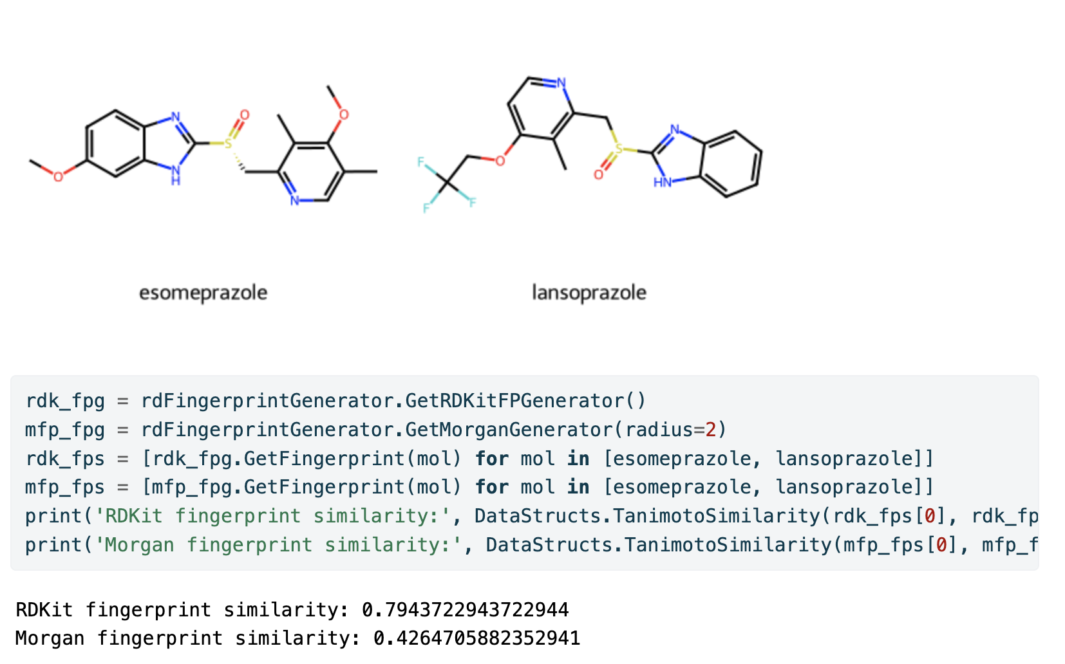
TANIMOTO SIMILARITY FOR FINGERPRINTS

Slide 91
TANIMOTO PROBLEMS
⚖️ No cutoff meaning „dissimilar”
🔀 May depend on SMILES representation
📐 May not comply with intuition

Slide 92
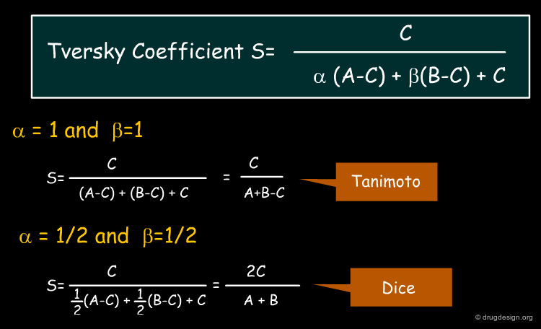
DICE AND TVERSKY SIMILARITY METRICS

Slide 93
DICE AND TVERSKY SIMILARITY METRICS
⚖️ Alternative measures for binary data
🔀 Dice emphasizes shared bits
📐 Tversky allows asymmetric weighting
🧠 Useful for scaffold-focused searches

Slide 94
COSINE SIMILARITY
📐 Measures angle between embeddings
⚡ Common for ML-based representations
🧮 Scale-invariant metric
❓ May not correlate with chemical intuition

Slide 95
DISTANCE VS SIMILARITY MEASURES
📏 Similarity: high = more alike
📉 Distance: low = more alike
🧩 Choice affects clustering and ranking
⚠️ Interpretation depends on metric properties

Slide 96
THRESHOLDS
❓ No universal cutoff exists
⚖️ Task-dependent thresholds
📊 Small changes can alter predictions
🧠 Raises questions about chemical meaning

Slide 97
METRIC-INDUCED BIAS
⚡ Choice of similarity metric skews results
📊 Different metrics produce different rankings
🧠 May over- or under-estimate relationships
❓ Can a metric reflect chemical meaning accurately?

Slide 98
REPRESENTATION-INDUCED BIAS
🧩 Fingerprints or embeddings encode assumptions
⚠️ Missing stereochemistry or tautomer info misleads metrics
💻 Representation choice affects ML models

Slide 99
A PROPERTY OF MOLECULES OR MODELS?
🤔 Depends on representation and metric
🧠 Similarity is a computational construct
⚠️ Chemical intuition may diverge from model outputs
📊 Encourages critical evaluation of predictions

Slide 100

DATABASES
🗂️ Enable storage of millions of molecules
🔍 Facilitate search and similarity comparisons
📊 Support QSAR and ML model training
⚠️ Accuracy depends on data quality

Slide 101
PUBCHEM: SCALE AND DIVERSITY
🌐 Contains tens of millions of compounds
🧪 Covers broad chemical space
📄 Includes chemical structures, properties, and identifiers

Slide 102
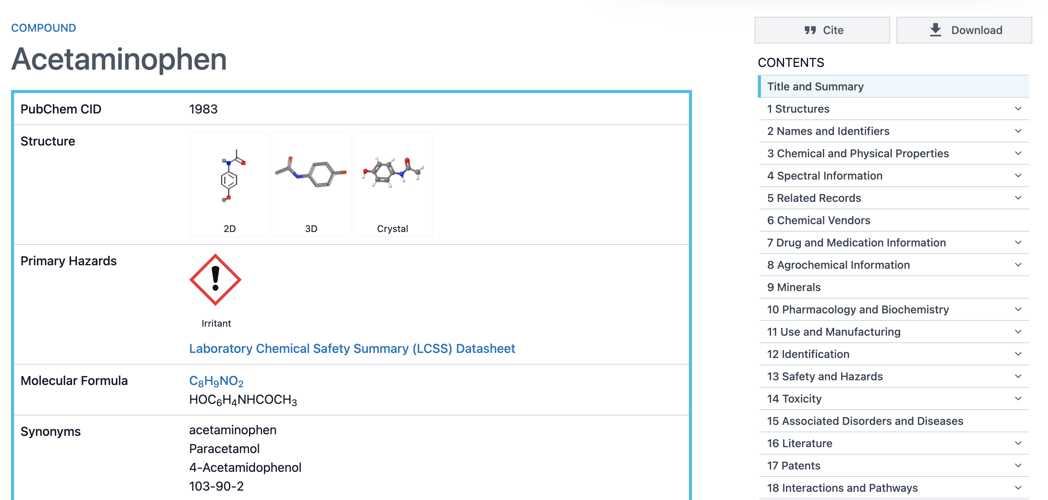
PUBCHEM: SCALE AND DIVERSITY

Slide 103
CHEMBL: BIOACTIVITY-CENTERED DATA
🧪 Focuses on compound-target interactions
📊 Provides IC50, Ki, EC50 and others
🔗 Links compounds to protein targets
💻 Supports predictive modeling and drug discovery

Slide 104
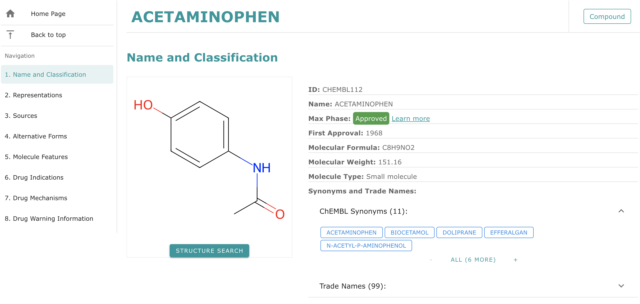
CHEMBL: BIOACTIVITY-CENTERED DATA

Slide 105
DRUGBANK: DRUGS AND TARGETS
💊 Focused on approved and experimental drugs
🔗 Contains target, pathway, and pharmacology info
🧠 Combines chemical, biological, and clinical data

Slide 106
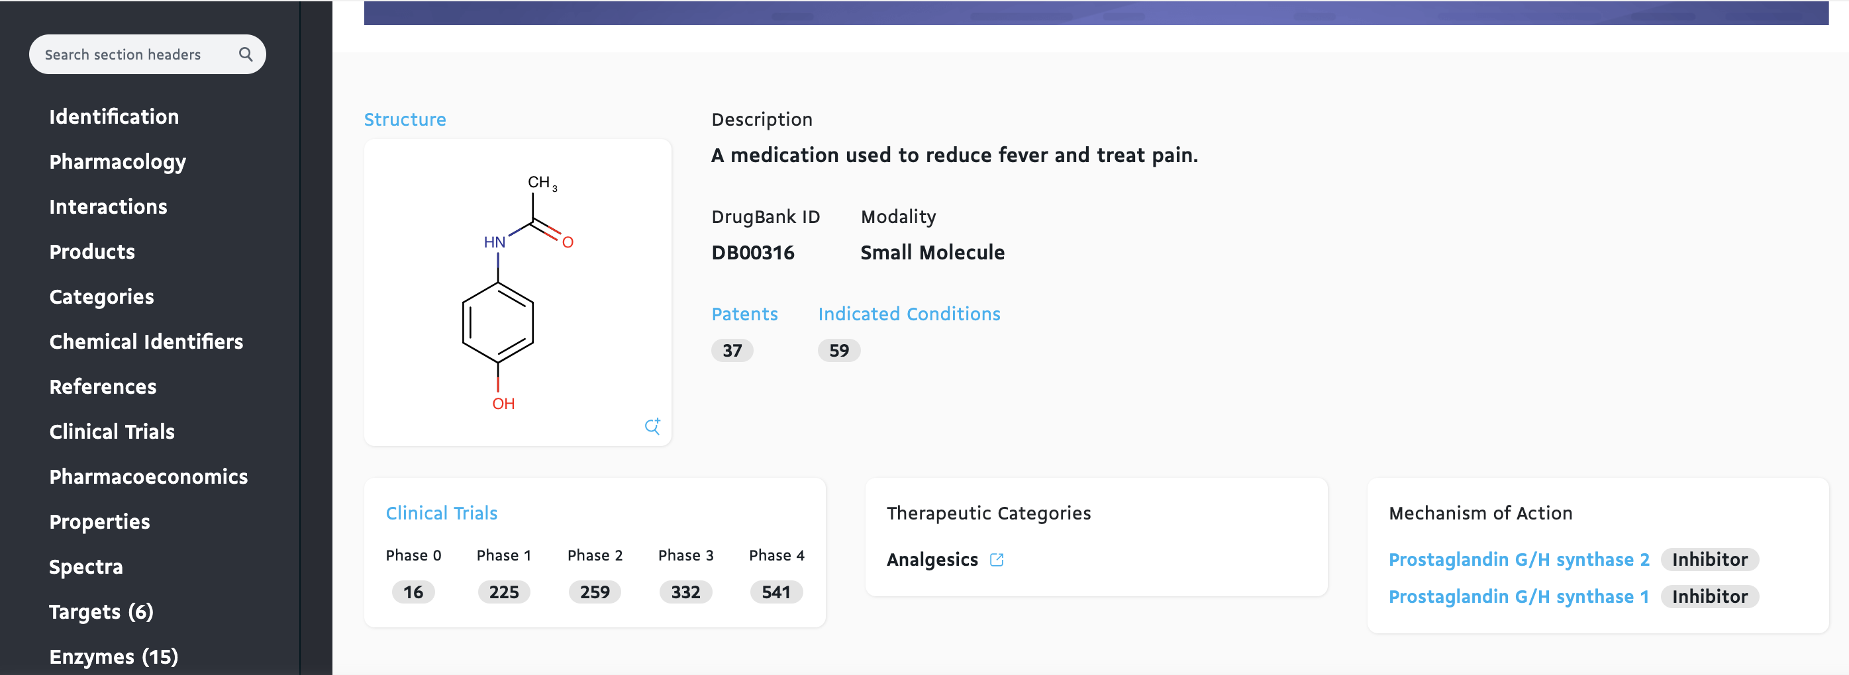
DRUGBANK: DRUGS AND TARGETS

Slide 107
PDB LIGANDS AND STRUCTURAL CONTEXT
🧬 Provides 3D structures of protein-ligand complexes
📐 Enables docking and interaction studies
🔍 Structural environment impacts binding
⚠️ Coverage is smaller than chemical databases

Slide 108
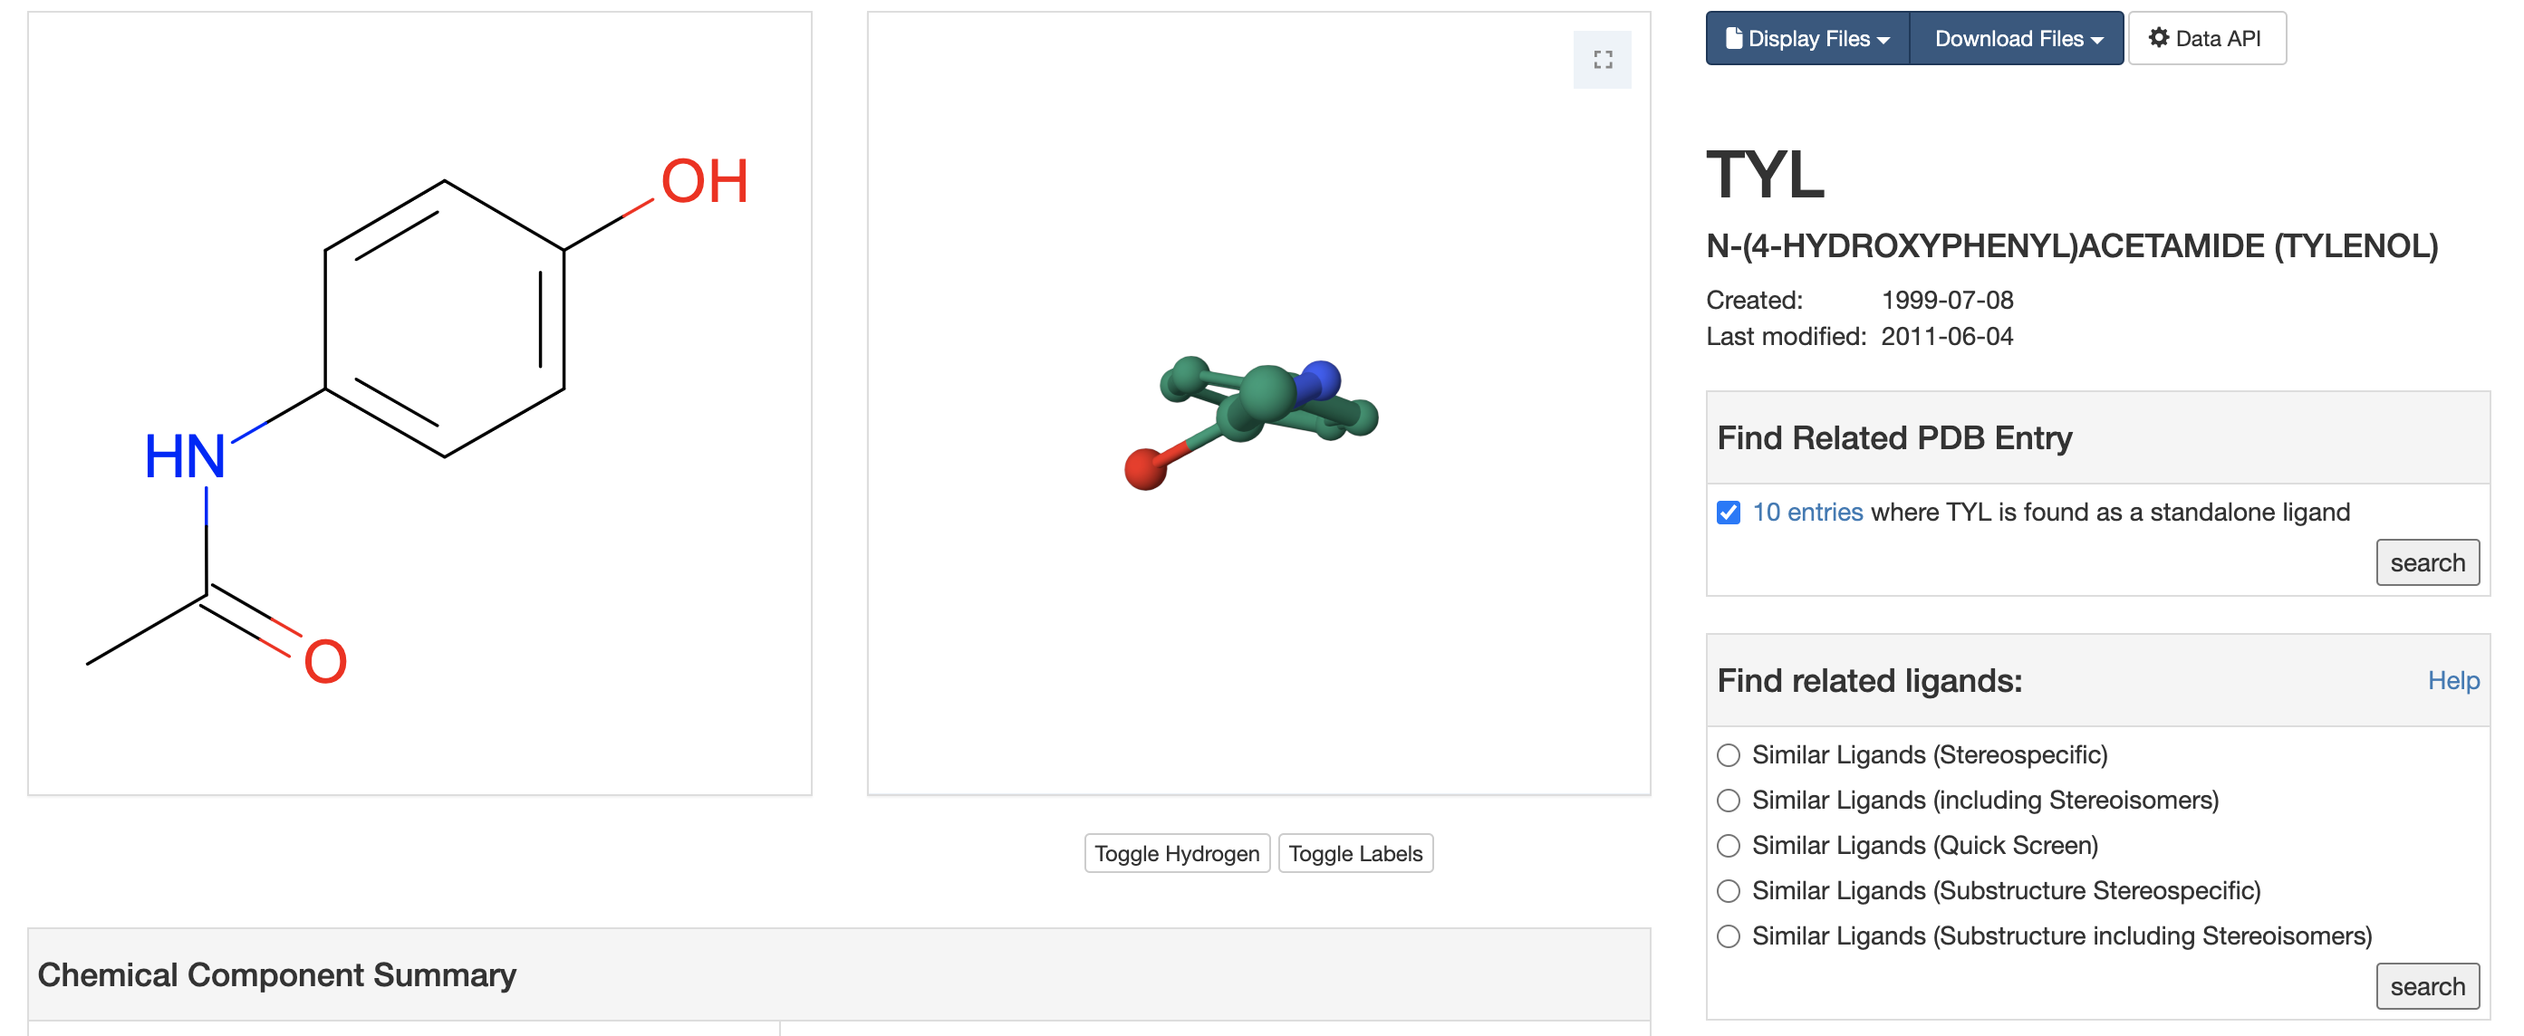
PDB LIGANDS AND STRUCTURAL CONTEXT

Slide 109
DATA QUALITY AND INCONSISTENCIES
⚠️ Errors in structures or annotations are common
🧪 Duplicate or missing data affects analysis
📊 Preprocessing and curation are crucial
🧠 Critical evaluation ensures reliable modeling

Slide 110

KEY TAKEAWAYS
🧩 Representation choice drives computation and analysis
🔍 Different tasks require different encodings
⚡ Algorithms operate on representations, not molecules

Slide 111
NO SINGLE “CORRECT” REPRESENTATION
❌ SMILES, graphs, embeddings each have pros/cons, but InChI, and InChIKey are good
⚖️ Choice depends on application and tool
📊 Canonicalization attempts are tool-specific
🧪 Chemical meaning can be lost in abstraction

Slide 112
REPRESENTATIONS ENCODE ASSUMPTIONS
🧠 Assumptions about stereochemistry, tautomers, or resonance
⚠️ Can introduce bias in similarity and ML models
🔍 Must understand what is represented and what is ignored

Slide 113
SIMILARITY IS TASK-DEPENDENT
📐 Fingerprint vs embedding similarity may differ
⚖️ Thresholds are arbitrary and context-specific
❓ Similarity may not correlate with activity
🧠 Provokes critical evaluation of predictions

